Slide 1
Cloud Providers, CI/CD, Secrets
Notes:
Jag: 1-8, 5 minutes
Bobby: 9, 2 minutes
Louis: 10-14 , 7 minutes
Brian: 15-19, 6 minutes
Louis: 20-24, 7 minutes
John: 25-33, 7 minutes
Bobby: 34-40, 7 minutes

Slide 2
Topic: Cloud providers, CI, CD, Secrets
Details: We’d like you to walk us through AOL’s use of cloud providers, starting from AWS and extending to any other major vendors you rely on (e.g. GCP). Please describe your overall account/organization structure, networking setup (VPCs, peering, hybrid connectivity), and how workloads are distributed across regions and providers. We’re interested in your standard building blocks (compute, storage, databases, messaging, serverless, containers), multi-account/multi-tenant strategies, and how you manage security (IAM, secrets, perimeter vs zero-trust models). Please also cover infrastructure-as-code tooling and practices, environment separation (dev/stage/prod), cost-management approaches, and any patterns you use for high availability, disaster recovery, and data residency.
Furthermore, we'd love to see how codebase is deployed in staging / production, which Continuous Integration (Screwdriver, Jenkins) is used and how much is automated of it. Finally, how secrets are stored, both for CI and workloads

Slide 3
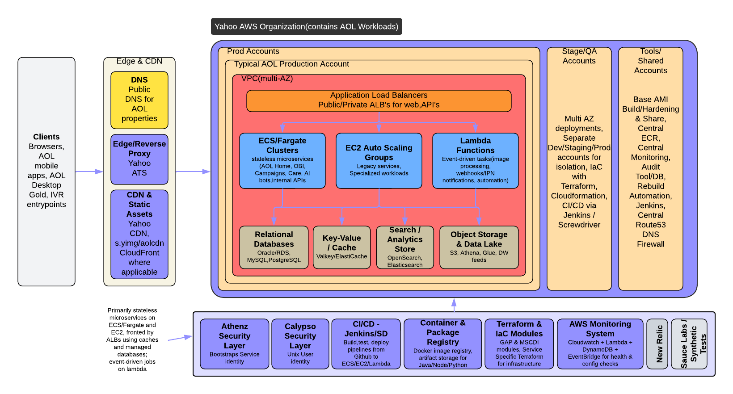
High Level Application Setup

Slide 4
Cloud providers
Currently we use two cloud providers. AWS is where most of our applications present.
AWS(59)
  Primary cloud provider for compute.
GCP(4)
  For Analytics and Firebase services.
Accounts are grouped like components together and separate security concerns.
  Example; Frontends, Services, PCI, Database, Data Warehouse, CI/CD, etc.
VPC Peering is used only as needed relying heavily on private link for interconnectivity

Slide 5
Multi-account/multi-tenant strategies
All accounts are part of Yahoo organization.
All accounts follow Baseline requirements. ( yo/baselines )
Most modern accounts built using AWS Happy Path guidelines ( yo/aws-happypath )
Production and Non Production(Dev/QA) are segregated.
Security & Compliance is managed centrally.
Apps are groups like ones together balancing security.
Notes:
AWS Happy Path Guide: https://git.ouryahoo.com/pages/aws/aws-guide/
AWS Baseline: https://git.ouryahoo.com/pages/baselines/cloud/aws/

Slide 6
Workloads distribution
Workloads are distributed based Business requirements.
Applications are categorized in to Tier 1 -3 as per BCDR.
Applications with Tier 1 are deployed in Multi region setup.
Applications with Tier 2 deployed into Single region with multi AZ.
Notes:
Tier 1: Mission-critical (must be restored immediately)
Tier 2: Important but not immediately critical (restore within hours)
Tier 3: Non-critical (can be restored within days)

Slide 7
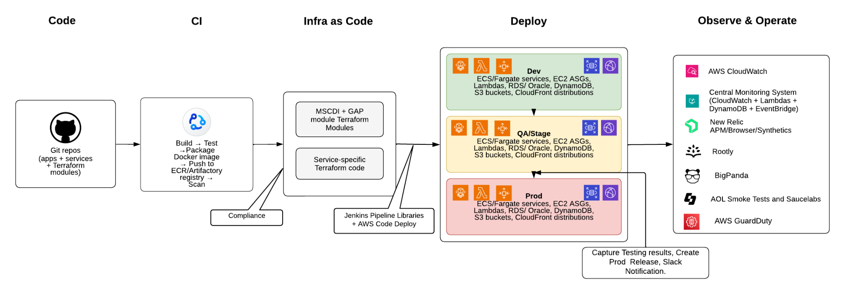
CI/CD & IaC
Notes:
Deploy -> All Deployments follow Blue Green Approach, we we deploy in idle environment , run tests , after successful testing we cutover to Live traffic.
Release -> Release entails to generate Release Notes using AI, Creating Git release in application repo and Change request ticket in Jira.

Slide 8
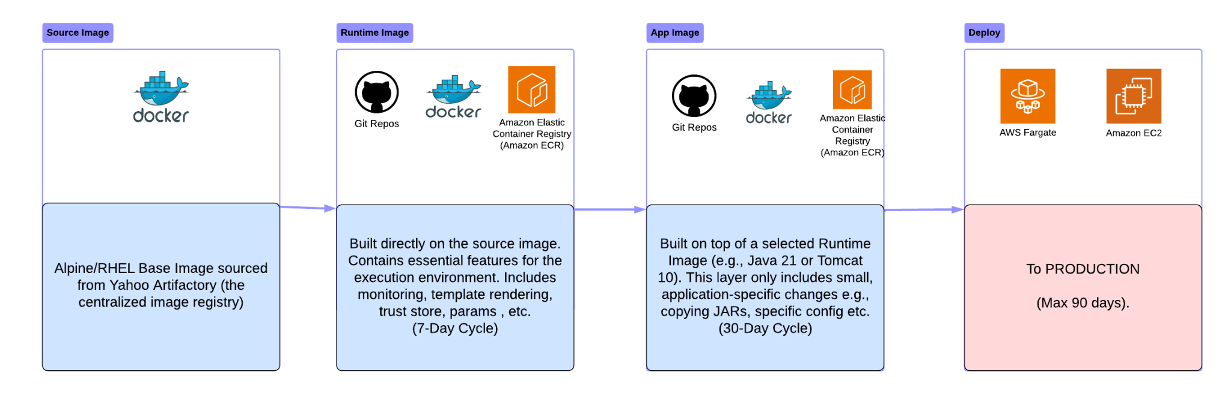
Docker Image builds
Notes:
SubTopic: standard building blocks
Base OS (Alpine) ->
Run time, -> Java + AWS Cli + NewRelic + JVM ARGS ..etc , Template rendering, parameter store /secret manager support, Trust store, file watchers for sia demon
> App image, in real world, you would see App container + Sia Container + Http container(Optional) as one application unit.

Slide 9
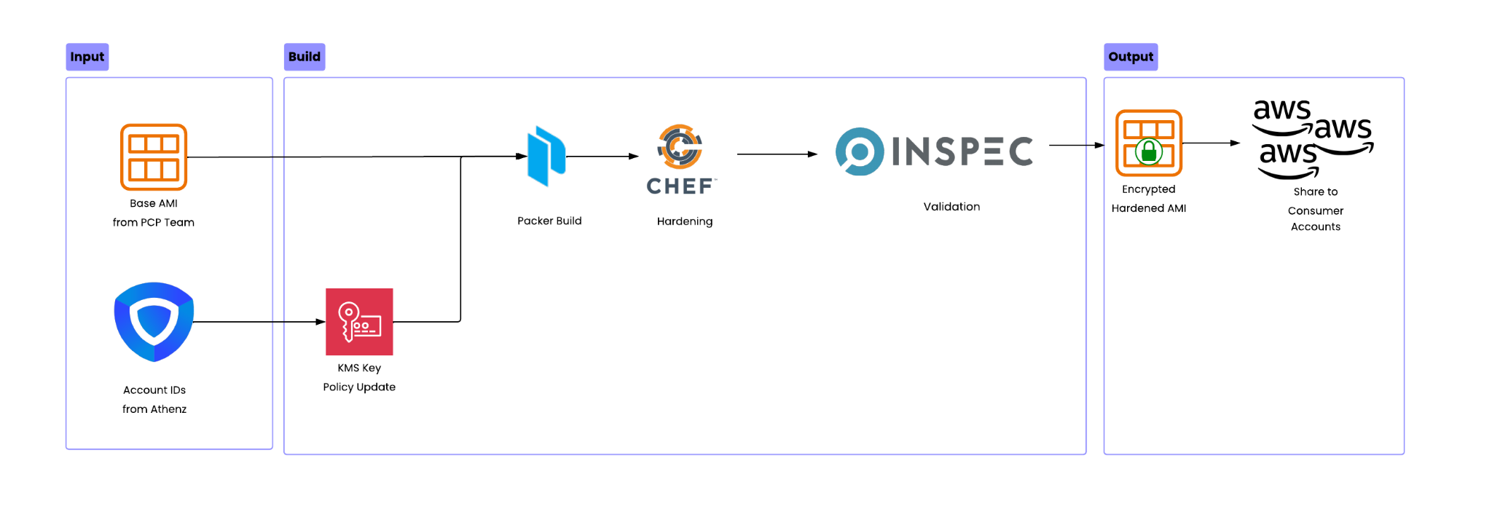
Icarus Image Build
Notes:
SubTopic: standard building blocks
Trigger: Weekly Thursday automated pipeline run (H H(12-14) * * 4)
Account Discovery: Queries Athenz for AWS account IDs from subscriptions, customer-care, pse, obi, aol-com, ce-self-help domains
KMS Setup: Creates/updates KMS key policy to allow all discovered accounts to decrypt AMIs
Infrastructure: Retrieves VPC and Subnet IDs from Terraform state
Packer Builds: Parallel builds for each OS (RHEL 8, Amazon 2023)
Hardening: Runs chef-icarus-hardening recipes to apply security configurations
Validation: Runs inspec-icarus-hardening controls to verify CIS benchmark compliance
AMI Creation: Creates KMS-encrypted AMI from hardened instance
Distribution: Shares AMI launch permissions and snapshot access with all consumer accounts
Detailed Flow: https://git.ouryahoo.com/SCC-devops/packer-icarus-hardening/blob/develop/docs/PROCESS-FLOW.md

Slide 10
GAP (Generic AWS Platform)
What it is: GAP is a series of Terraform modules and CICD template for building and maintaining the VPC and other critical network infrastructure for our AWS accounts.
Terraform Module:
  Creates and manages the following resources;
    VPC
    Subnets
    NACL’s
    Route Tables
    Endpoints
    Bastion peering
    Some central security groups
Pipeline Libraries ( Screwdriver ):
  Provides Step functions for;
    Authentication and role assumption
    Terraform plan and apply
Notes:
Louis:

Slide 11
MSCDI
What it is: Member Services Common Deployment Infrastructure or ‘MSCDI’, is a set of code modules written in Terraform and Groovy that work together to deploy common applications to AWS Fargate in a repeatable and codafiable manner.
Terraform Module:
  Creates and manages the following resources;
    IAM Roles, IAM Policies
    KMS Keys, KMS Policy
    Load Balancer, Target Groups, Listeners
    Cloudwatch Logs, Cloudwatch Alerts, Cloudwatch Metrics
    ECS Cluster, Code Deploy Group
    Fargate Service, Fargate task, Autoscaling policy
    Central ECR Registry, Repositories, Region Replication, Lifecycle Policy
Pipeline Libraries ( Groovy code for Jenkins ):
  Provides Step functions for;
    Authentication and role assumption
    Container building, scanning, publishing and tagging
    Application deployment and deployment testing
    Misc functions for source code management, release tagging, Slack/eMail notifications, etc
    Container Testing and Uploading Results to Automation
    Release Summary Generation
    Jira QAR Creation, Installation Notification
Notes:
Louis:

Slide 12
Fleks
Fleks is a powerful Yahoo Home grown CLI utility to create and manage EKS clusters, ensuring clusters are compliant with Yahoo security policies.
Focuses is on ease of use while enforcing best practices
Requires minimal configuration to stand up ready-to-use cluster
Uses official EKS AMI with Yahoo!-specific requirements layered on top
Creates and manages control plane and nodegroups via CloudFormation
Requires minimal out-of-band (API) changes
Notes:
Louis:

Slide 13
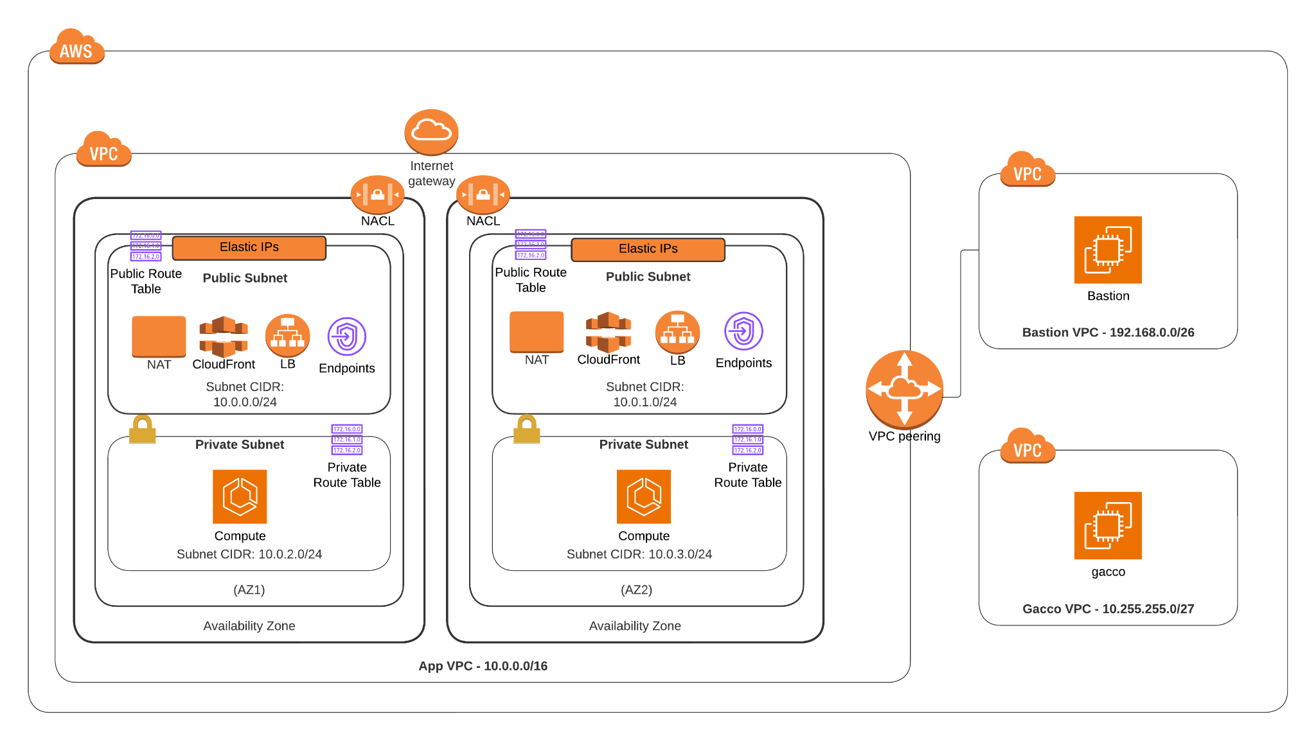
Standard AWS Account - Network
Notes:
Subtopic: Networking setup
AWS VPC’s are built via a Terraform module ( GAP ) with specific configurations for each account.
Built with public/private split where the Internet Gateway attaches only to the public subnets.
Managed NATs provide connectivity for private resources.
Each layer gets its own NACL set and Route tables. No defaults are used.
Endpoint services are deployed wherever possible.
Inter-account connectivity is done on as-needed basis only through VPC peering.
PrivateLinks

Slide 14
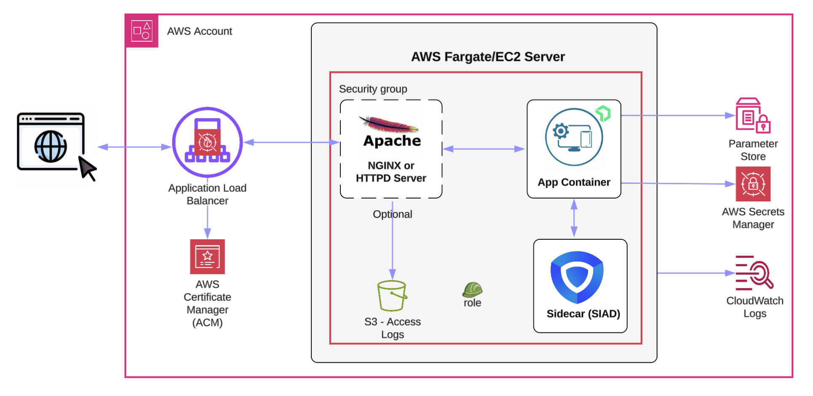
Typical Application composition
Notes:
SubTopic: standard building blocks

Slide 15
GCP Accounts
Google Services, Products & API’s
  BigQuery
  Google Cloud Storage (GCS)
  Gemini
  Firebase Cloud Messaging
  Firebase App Check
  Firebase installations

Slide 16
GCP - MS Data Account
Primarily used for Data Warehouse
  Machine Learning
  Colab Enterprise
  VertexAi
  Gemini
Compute
  Colab Enterprise
  Workbench/Jupyter Notebooks
Created and managed by terraform code
  IAM - (managed by terraform)
  Infrastructure - VPC - (managed by terraform)
Infrastructure
  VPC (managed by terraform)
    2 regions - Each region has (1 subnet, Cloud Router, Cloud Nat)
    Private Access Enabled
    Standard network
    No public IP addresses (0 Public subnets)
    Firewall settings

Slide 17
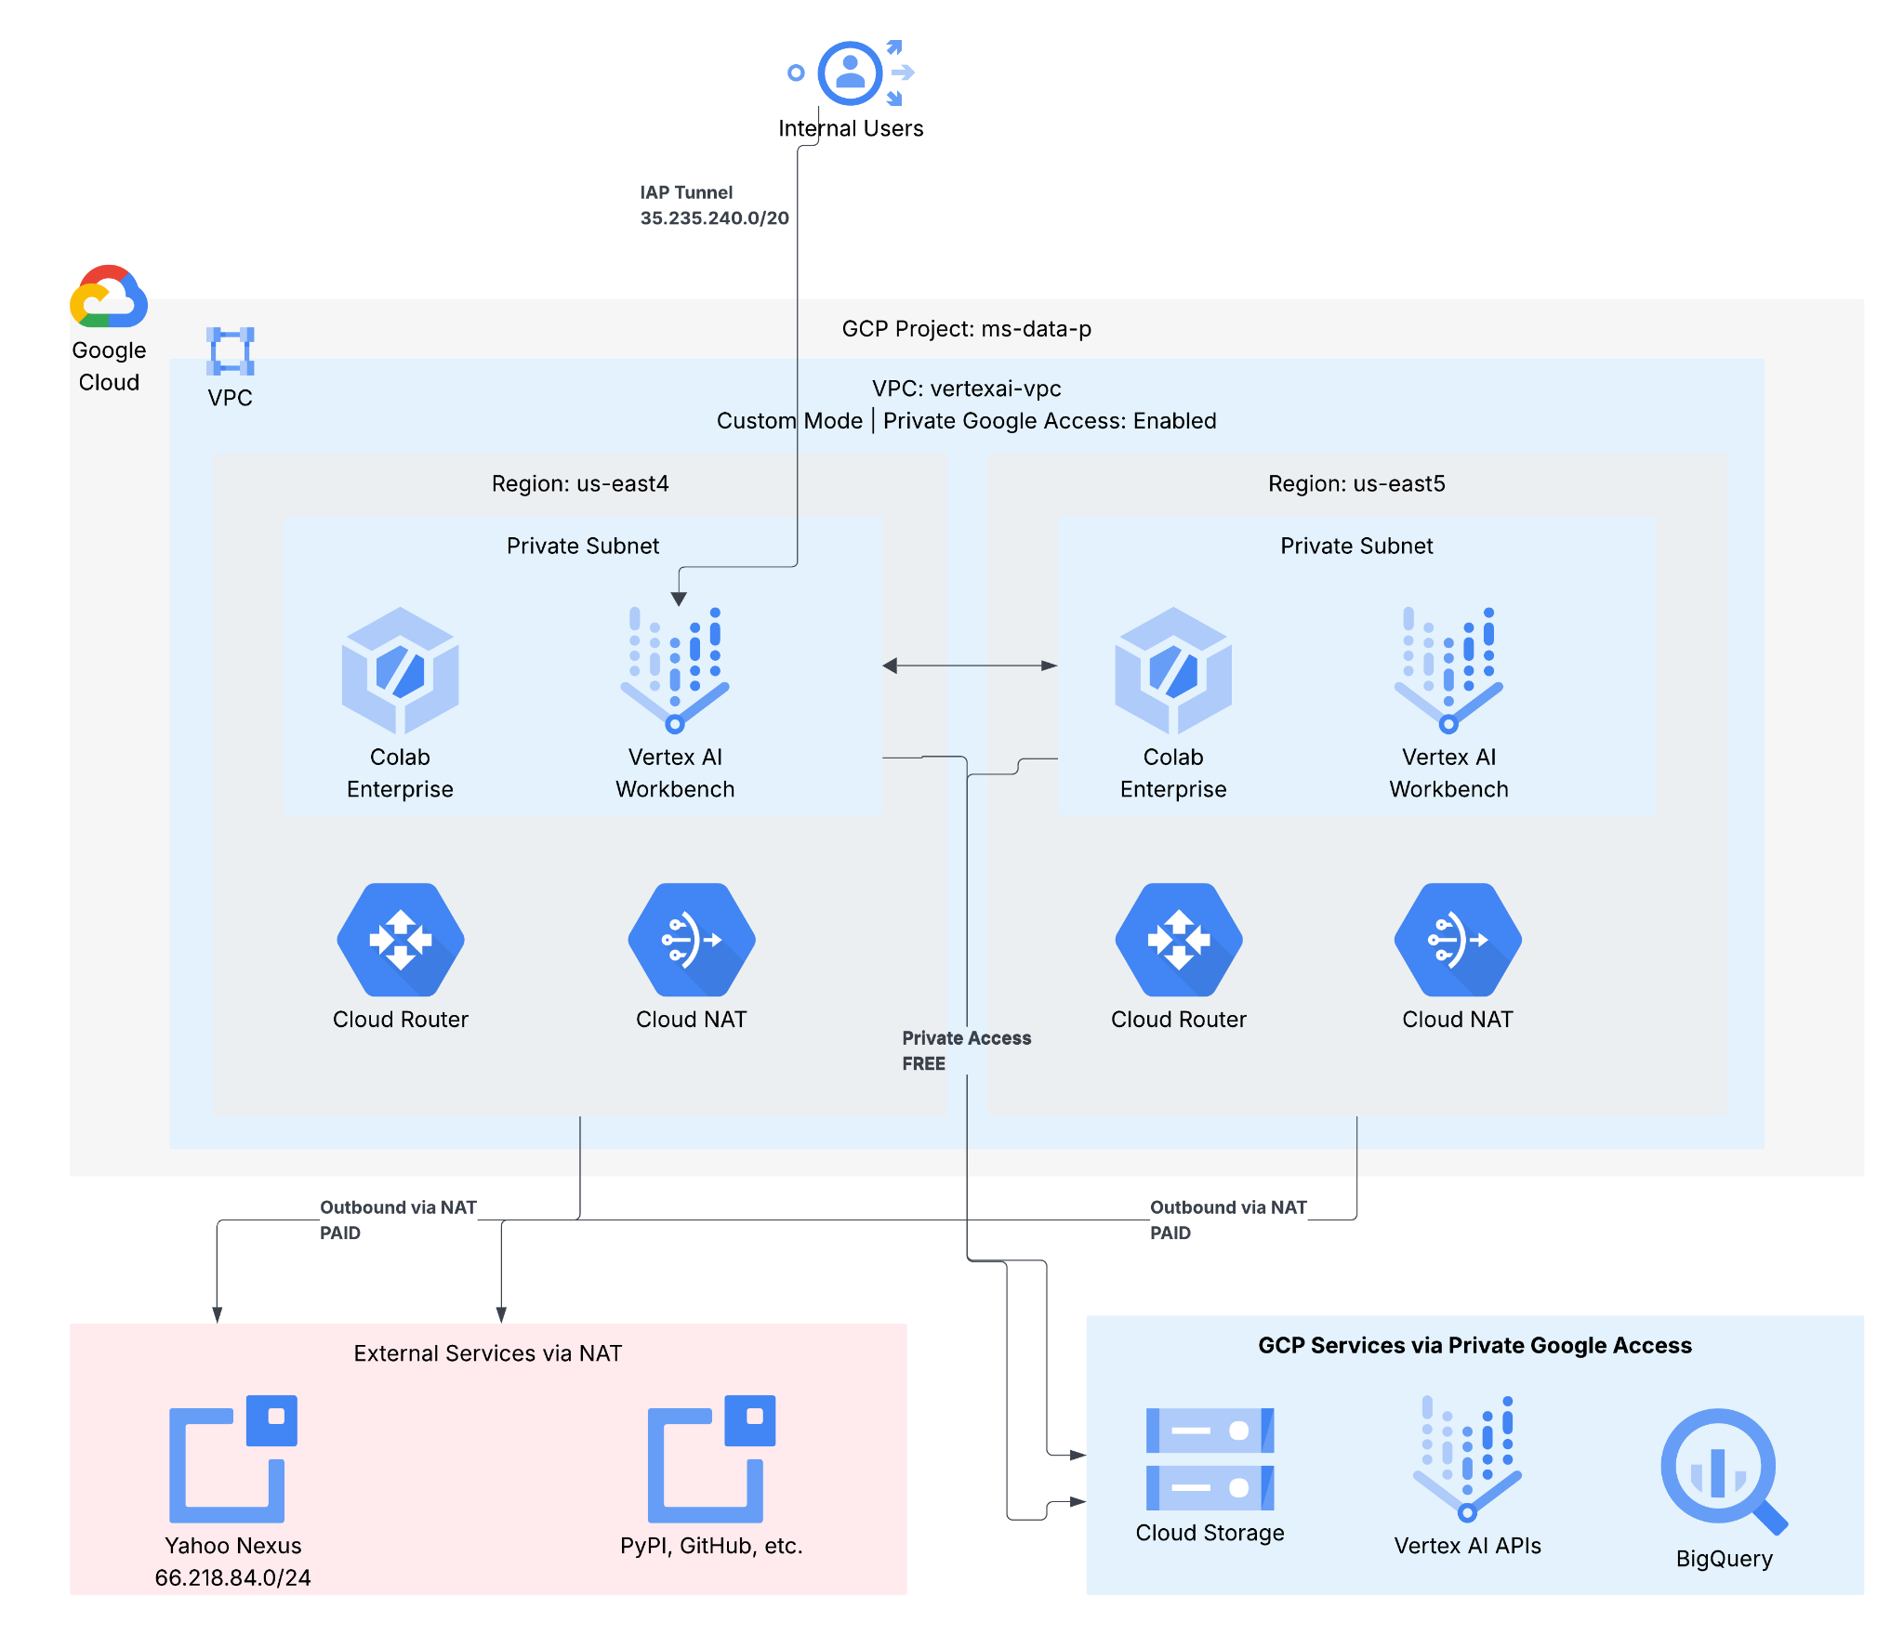
GCP Account (ms-data-p) - Vertex AI and Colab Enterprise

Slide 18
Cost Management Approaches
Strategic Purchasing & Financial
  Reserved Instances in case of long term use.
  AWS Enterprise Discount Program (EDP) program.
Resource Optimization
  Right Sizing of applications by matching resource allocation to actual workload requirements
  Tuning resource parameters to maximize usage.
  Reduce expensive DB instance type and sizing by tuning queries, adding indexes, and optimizing memory parameters
Architecture & Operations
  Adoption of Serverless Architectures (Lambda, Fargate, Batch)
  Automated Shutdown of Non-Production Resources (non-office hours)
  Identify and delete unused Amazon Elastic Block Store (EBS) volumes
  Enforce standardized tagging across all resources for transparent cost reporting by team or project.
Notes:
Valkey and Redis for elasticsearch

Slide 19
Security

Slide 20
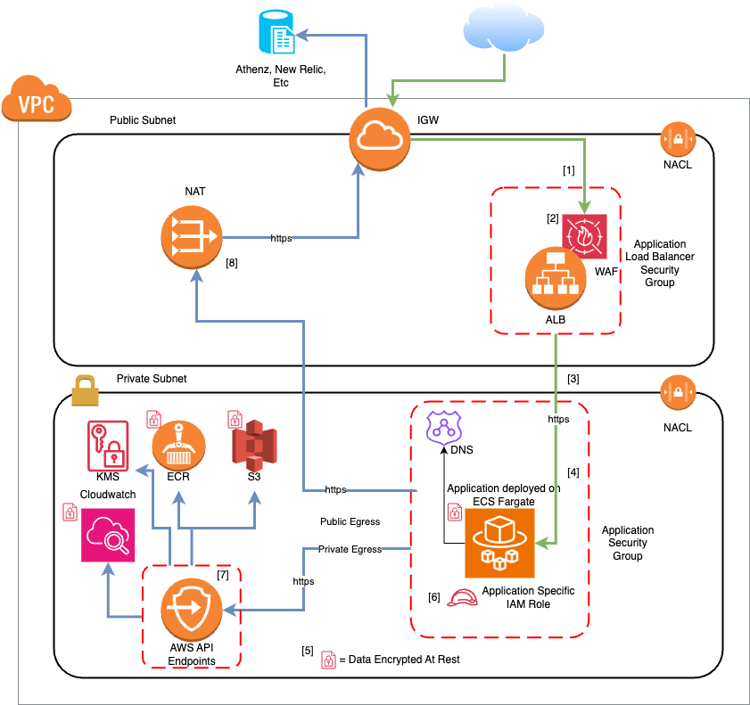
Standard Security Controls
    [1] - L4 Firewall (SG) in front of Load Balancer
    [2] - L7 Firewall (WAF) in front of Load Balancer
    [3] - Traffic to application encrypted
    [4] - L4 Firewall (SG) in front of application
    [5] - All data encrypted at rest
    [6] - Application Specific IAM Role used for permissions
    [7] - All necessary AWS API endpoints terminated internally inside the VPC
    [8] - Public API endpoints egress through managed NAT service
Notes:
Louis:

Slide 21
Security
General:
Applications are deployed into separate accounts based on security level, content, or access requirements
Accounts are peered only with specific network requirements such as (*)centralized database access
DEV and PROD environments are separated at the account level
User access is controlled via Athenz (SAML ) with our DMT tool to ensure centralized management
All accounts have AWS Guard Duty enabled by default
Cloudtrail is enabled by default
Yahoo Gacco is deployed by default and monitors cloud governance compliance
Network Security:
VPC’s built with dual network zones
  Public - Attached to an IGW for Load Balancers
  Private - No IGW, uses Managed NAT’s for egress, no public ingress
Independent NACLs for each zone
Independent Route Tables for each zone
Localized DNS resolution via Route 53
AWS Public API access terminated with internal endpoints where possible
Notes:
Parameter store used in most cases. Secrets Manager is used for RDS secrets (utilizing secret rotation), very large secrets and secrets that need to be replicated across regions.
5 Min Jag

Slide 22
Security Cont.
Application Security:
Applications have their own unique Security Groups ( Stateful Firewalls )
Load balancers have their own unique Security Groups per application
Each application get it’s own unique IAM role with limited permissions as needed
Most production applications are deployed in Serverless environments with no SSH access
EC2 based applications deploy with security daemons by default (Nessus and SentinelOne )
AMI’s for EC2 built on specially hardened Icarus images refreshed at a maximum of 120 days
Application containers scanned for security issues automatically in the registry by default
All ECR images refreshed at a maximum of 90 days
ALB’s protected via Web Application Firewall ( WAF )
IAM:
Admin permissions restricted to only federated user roles only. No headless admin permissions.
Each application has individual roles and policies, built on the principle of least-privilege.
Cross account roles for CICD and Monitoring are allowed with specific trust policies limiting role assumption to only specific external roles.
User logins are only available through SAML federation. No root user access is allowed.
Notes:
Parameter store used in most cases. Secrets Manager is used for RDS secrets (utilizing secret rotation), very large secrets and secrets that need to be replicated across regions.

Slide 23
Security Cont.
Secrets:
AWS Secrets manager and Parameter Store
All secrets encrypted with individual KMS Customer Managed Key with application specific policies.
All database secrets are enabled for auto-rotation.
Access Control and Least Privilege to retrieve the secret and parameter using strict IAM policies on the consuming roles.
Zero-Trust:
We use a policy of zero trust when making security decisions. This includes items such as end to end encryption, mutual TLS authentication, and unique applications specific keys and policies vs shared objects.
Notes:
Parameter store used in most cases. Secrets Manager is used for RDS secrets (utilizing secret rotation), very large secrets and secrets that need to be replicated across regions.

Slide 24
CI/CD

Slide 25
CI/CD Platforms & Architecture Overview
CI/CD Platforms:
• Jenkins
• Screwdriver
Environment Segregation:
• Development and production environments are fully separated
• Ensures controlled access, risk mitigation, and operational integrity
• Aligns with Paranoids security best practices
Jenkins Organizational Structure:
• Customer Care Member Services (CCMS)
• Data Warehouse (DW)
• Open Business Infrastructure (OBI)
• Billing Revenue Repository (BRR)
• AOL Desktop Gold (ADG)
Notes:
John:

Slide 26
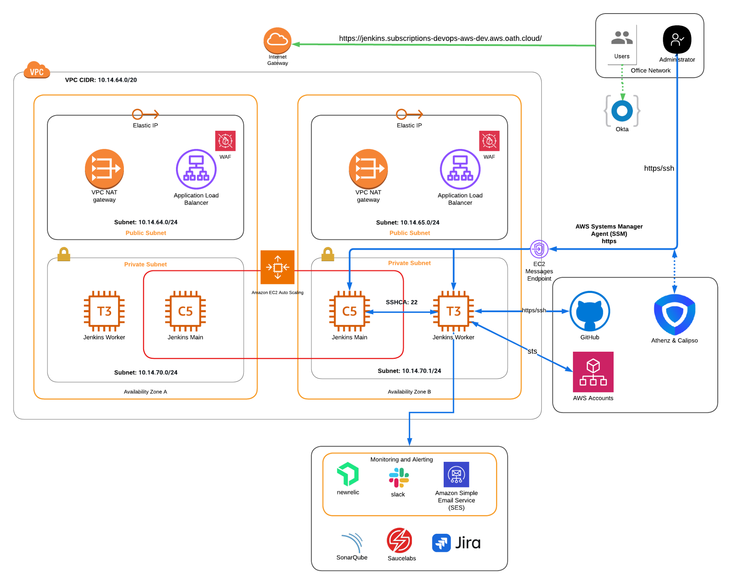
Jenkins
Our development workflow utilizes Jenkins as the central engine for CI/CD, enabling us to automate the full software delivery lifecycle from building docker images, verifying code, running unit tests, to preparing and deploying application releases incorporating a “blue/green” configuration.
Components:
docker
jenkins
nginx
ssh
Security:
Okta
WAF/WAKL
Security Groups
Jenkins matrix-based security
Calypso
IAM Roles for cross-account access
Monitoring:
Newrelic
AWS Grafana

Slide 27
Jenkins Infrastructure Configuration:
Provisioned via AWS CloudFormation for consistent, repeatable infrastructure deployment
Access controlled through WAF network filtering, corporate NAT IP allow-listing, and Okta SSO enforcement
Build and execution workloads distributed across scalable Jenkins worker nodes
Worker node AMIs rebuilt and deployed weekly through automated packer image pipelines
Automated S3 backups executed twice daily to support recovery point objectives
Jenkins-main instance protected by Auto Scaling with automated restoration from latest validated backup
Monthly plugin maintenance cycle with Dev environment validation prior to Prod rollout
Pipeline health and execution notifications integrated with Slack and AWS SES SMTP relay
Jenkins health checks and operational alerts are monitored through New Relic for real-time visibility and incident response
Pipeline execution metrics are collected via the Prometheus plugin and visualized in AWS Grafana for performance and trend analysis

Slide 28
Jenkins Statistics
Number of Jobs:
ORGANIZATION | DEV | PROD
Customer Care Member Services (CCMS) | 239 | 110
DataWarehouse (DW) | 82 | 102
Open Business Infrastructure(OBI) | 164 | 51
Billing Revenue Repository (BRR) | 210 | 59
Aol Desktop Gold (ADG) | N/A | 21

Slide 29
Jenkins Statistics cont’d
Daily Pipeline Runs:
ORGANIZATION | DEV | PROD
Customer Care Member Services(CCMS) | 417 | 56
DataWarehouse(DW) | 6 | 155
Open Business Infrastructure(OBI) | 140 | 13
Billing Revenue Repository(BRR) | 34 | 59
Aol Desktop Gold(ADG) | N/A | 6

Slide 30
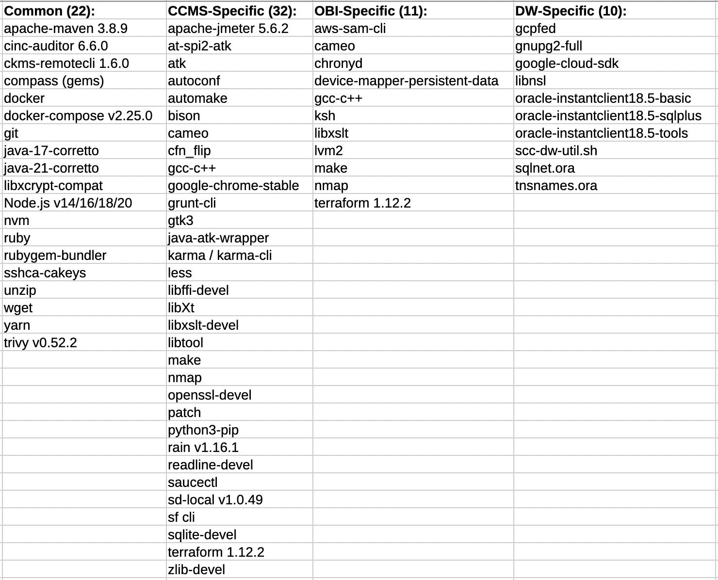
Jenkins-Worker Installed Packages

Slide 31
Screwdriver
Screwdriver is a new open-source continuous delivery tool with no proprietary technologies, meaning it is deployable anywhere. It’s built on the latest and greatest technology from the open source world.
Screwdriver is built from the ground up with a focus on making it easy to build, test, and deploy software using Docker instances of your chosen build/test/deployment environment.
In our environment starting a Screwdriver job results in the screwdriver server pulling the specified Docker image(s) from our repository images and executing commands from the screwdriver.yaml file in the image(s). The images on which build and test are executed are the target images for your application (iOS, Android, python for this documentation repo, etc.).
Primarily, we use Screwdriver for infrastructure deployment workflows, mobile application build pipelines, automated Checkov compliance and policy scans, and Packer-driven creation of Amazon Machine Images (AMIs).

Slide 32
Secrets Management for CI/CD & Workloads
Jenkins
Credential Store
  Native Jenkins Credentials plugin for secure secret storage and injection
  Credentials for Git, SonarQube, Saucelabs, JIRA, Slack, Screwdriver, etc.
Cross-Account Access
  IAM Roles with AssumeRole for secure cross-account AWS operations
SSH Keys
  Agent communication (controller ↔ worker nodes)
  Secure file transfer to Build Release Repository (BRR)
External Secrets
  AWS Systems Manager Parameter Store for pipeline-specific secrets
  Headless Okta service account for JIRA API integration
  Headless Okta service account for cross-environment job triggers (Dev → Prod)
Screwdriver
Pipeline-Scoped Secrets
  Secrets defined and stored at the pipeline level
  Runtime injection into jobs via explicit configuration
  Isolation ensures secrets are only accessible to authorized pipelines

Slide 33
Devops Tools

Slide 34
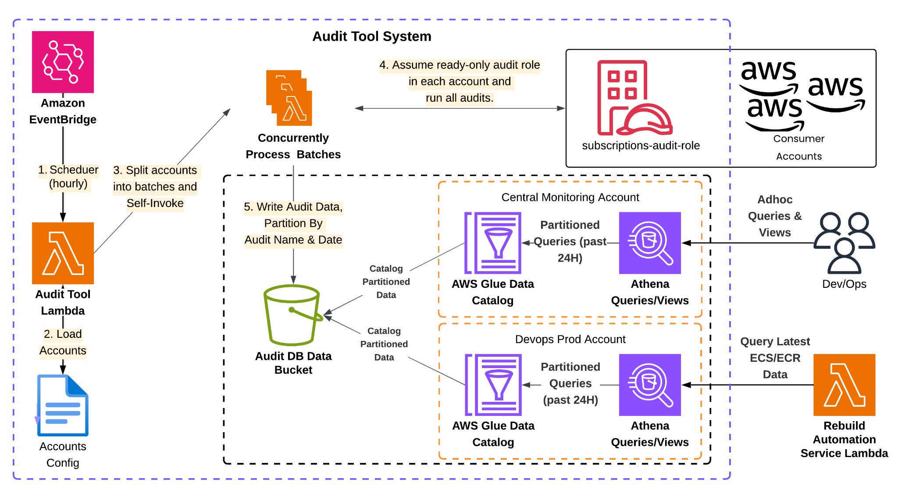
Audit Tool
Notes:
Audit Highlights.
Can be used on a control-by-control basis or to pull data into our Audit DB for further analysis/auditing.
AMI - Ensure Image Age (<90d), Encrypted and OS-Hardened
Container - Pull ECS Data about running container images to aggregate with ECR data.
ECR - Ensure Image Age (<70d), Get Image Scan Vulnerability Data (ensure no Critical or High), Ensure Repo Size (<250 images)
EBS - Ensure Encrypted, Using CMK and Attached
Gacco - Ensure Governance Compliance of Gacco Version
MultiAZ - Ensure DB’s and ASG’s are Multi-AZ
Cloudwatch - Ensure Logs Retention Policy Enabled
WAFv2 - Ensure Cookie Logging Redactions
Lambda - Pull Lambda Data for further auditing.
RDS - Pull RDS Data for further auditing.
Route53 - Ensure no dangling DNS.
Trusted Advisor - Pull all TA data for further auditing.

Slide 35
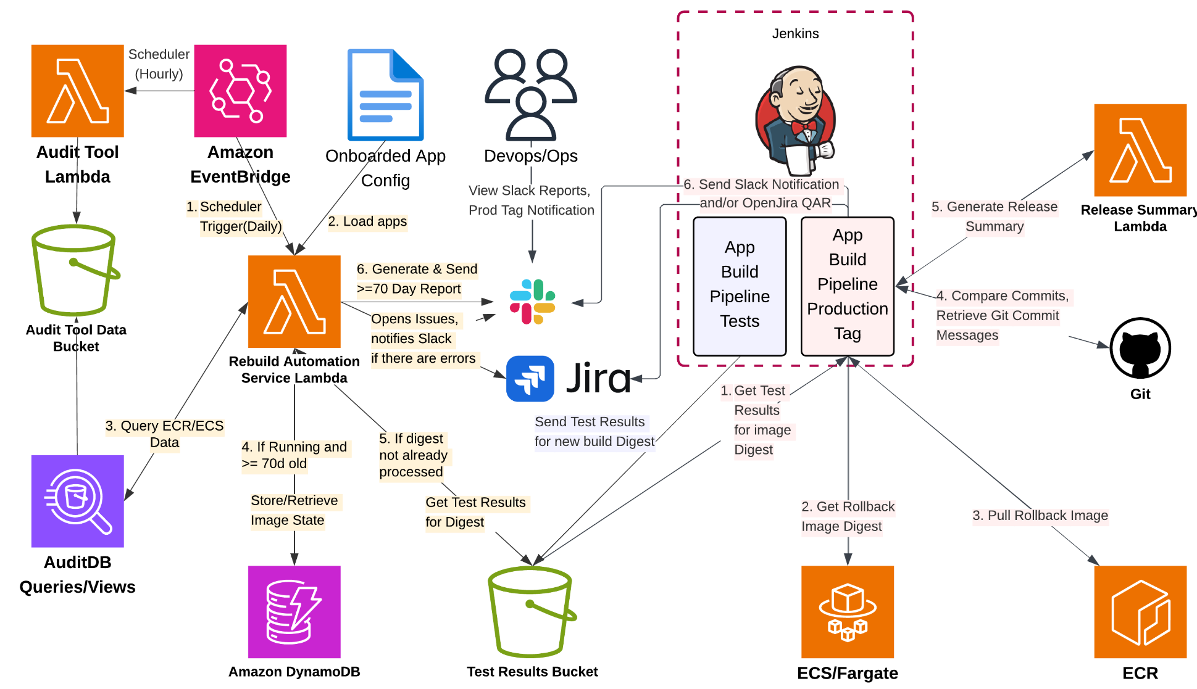
ECR Rebuild Automation
Notes:
Rebuild Automation Service Lamba:
Event bridge kicks off Rebuild Automation Service Lambda Daily.
Queries Audit DB, identifies all the images reaching >70 day threshold.
Creates a slack message indicating images breaching the control.
Stores current image state in DynamoDB like current running image in prod, current QA image, Test result ..etc,
Resulting report will be posted to Slack, Incase of error Jira ticket will be open, if jira creation fails falls back to Slack with error message.
As part of regular application pipelines, QA images are tested and results are published to S3 bucket.
Ops Trigger Prod tag Job, which does check S3 for test results, ECS for rollback docker image tag, and confirm digest is valid in ECR. Using git default branch and last release capture all changes and send info to Release summary, once Release summary is generated create Release in git.
Once Release is created in GIT, Change request is generated in Jira and notification send in Slack.
ProdTag Function Flow with Automation
Pull tests details,
Get rollback details (rollback tag, image and digest)
Pull docker image with qa tag
Get the Commit-Id (org.label-schema.vcs-ref) from Docker Label (of the qa tag)
Compare commit-id from Docker label of qa image -> MUST match commit-id of current pipeline (exit with failure if not)
Find current production git tag
Tag the current qa image with new production tag, which is incremented +1 from the currently found production tag.
Push docker image to ECR with tag,
Take rollback tag and find the git commit with the same tag.
Invoke ReleaseSummary Lambda, passing the base (rollback) and head commit (newest) in the payload.
Lambda pulls all commit messages between the 2 commits and uses Open AI to generate and return a Release Summary.
Apply and push the new production git tag
Create Install Qar (Jira Issue) and/or Send Slack Summary, passing New Production Image Details, Rollback Details and Release Summary.
Pull the Test Results for the image digest.
Using all gathered info (Prod & Rollback Image Details, Test Results, Release Summary) send a Slack Summary Notification and/or open QAR. Pre-defined install steps (configured for each app) are added to QAR's (and can be added to Slack Summary if desired). For any test where a report has been uploaded, it will get attached to the QAR, and it's S3 location will be added to the Slack Summary.

Slide 36
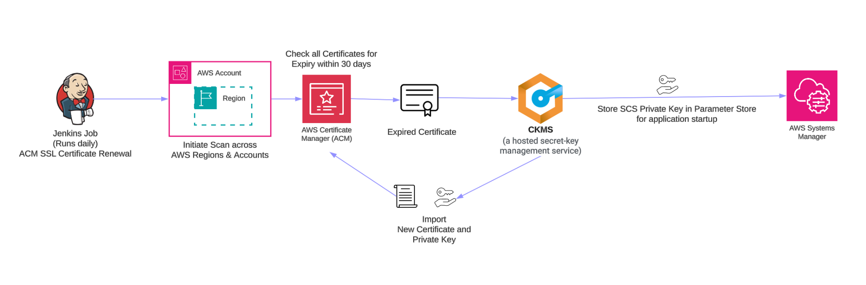
SSL Certificate Renewal - ACM (Non Athenz)

Slide 37
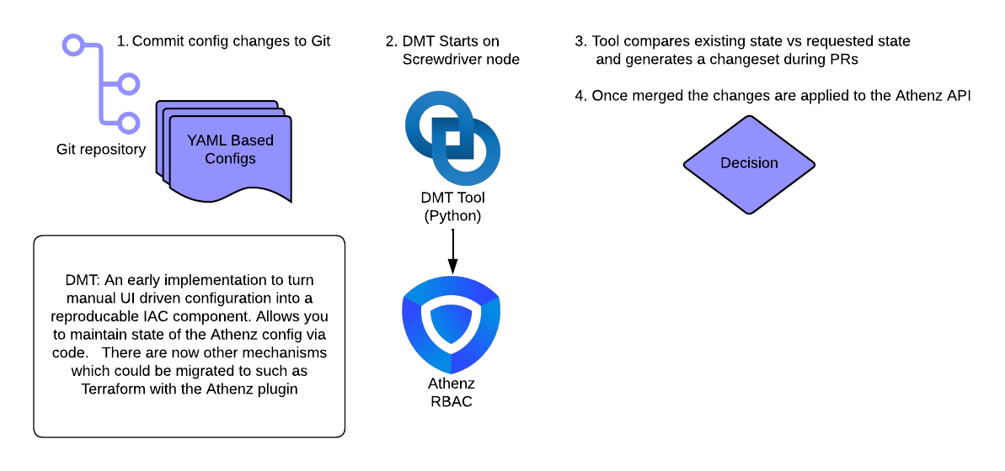
DMT (Athenz Domain Management Tool)

Slide 38
DevOps Managed Services
Jenkins (CI-CD / Automation Server)
  infrastructure, plugin management, security patching, backups, and monitoring
SonarQube (Code Quality)
  infrastructure, security patching, and monitoring
Superset (Reporting)
  infrastructure, security patching, and monitoring
Dependency Tracker (OWASP Dependency-Track)
  infrastructure, security patching, and monitoring

Slide 39
DevOps Managed Tools
Audit Tool: Automates compliance checks and resource tracking to ensure infrastructure follows regulatory standards.
Central ECR Registry: Provides a single, secure source of truth for storing and managing container images across the organization.
Centralized Security Group: Standardizes firewall rules and network access controls to ensure consistent security across all VPCs.
Cloudwatch Dashboards: Provides real-time visual monitoring and performance insights for cloud infrastructure and applications.
Core Deployment Modules: Reusable Infrastructure-as-Code (IaC) templates that ensure standardized, rapid environment provisioning.
Domain Checker: Automatically monitors domain availability, expiration dates, and DNS health to prevent service outages.
Domain Management Tool (DMT): Athenz configuration & deployment (CI/CD for Athenz configuration for all accounts)
ECR Rebuild Automation: Triggers automatic container image updates and to patch vulnerabilities and keep dependencies current.
GAP tools: Tools for creating and maintaining infrastructure states adhering to desired security or compliance baselines.
Jenkins: The primary automation server used to orchestrate continuous integration and delivery (CI/CD) workflows.
Jenkins Pipeline libraries: Shared, version-controlled code snippets that standardize and simplify CI/CD pipeline configurations.
Public Endpoint Detection: Scans for and alerts on internet-facing assets to prevent accidental exposure of sensitive internal services.
RemoteCurl: A utility for testing target health check connectivity from remote network.
Route53 Firewall DNS: Filters outbound DNS queries to block connections to known malicious domains and prevent data exfiltration.
Sandbox Rehydration: Automatically wipes and recreates development environments to ensure they remain clean and consistent.
SSL Certificate Renewal: Automates the lifecycle of digital certificates to prevent downtime caused by unexpected expirations.
Windows Active Directory: Manages centralized identity, authentication, and access control for Windows-based systems and users.

Slide 40
Data residency
All the data is in US only except call center data for EU.

Slide 41
Appendix

Slide 42
DevOps Tools List
Category | Tools in Use
Source Control | Git Enterprise, GitHub
Continuous Integration (CI) | Jenkins, Screwdriver
Artifact Management | Artifactory, Nexus, AWS ECR
Testing & Quality | Selenium/Jmeter, JUnit, Cypress, SonarQube
Application Security | ECR Scan, Trivy, Checkov, Dependabot, Dependency-Track, Tetradio
Configuration Management (CM) | Packer
Infrastructure as Code (IaC) | Terraform, AWS CloudFormation
Containerization | Docker
Container Orchestration | Amazon ECS/Fargate
Continuous Delivery (CD) | Jenkins, AWS CodeDeploy, Screwdriver
Monitoring & Logging | AWS CloudWatch, New Relic
Reporting & Visualization | Superset, CloudWatch Dashboards
Incident Management | BigPanda, Rootly
Change Management & Issue Tracking | Jira
File Transfer | GoAnywhere sftp

Slide 43
Glossary
Athenz — What it is: Yahoo’s internal authN/Z platform for service x.509 certs and role-based service-to-service auth. How you use it: Register services/roles; workloads obtain certs via SIAD; clients/servers verify with Athenz libraries. Owner/Slack: Security Platforms (#athenz).
awsfed2 — What it is: CLI to obtain federated AWS STS credentials via Okta; stores in ~/.aws/credentials. How you use it: Run awsfed2, select role (e.g., aws.fed.admin.user), then use AWS CLI with that profile. Owner/Slack: Cloud Platforms/PCP (#aws, #cloud-community).
Bastion (AWS PCP) — What it is: Managed bastion stack to reach private subnets; provision/update via bastion-cli; EL‑8/Alma* AMIs shared org‑wide. How you use it: Prefer SSM; if needed, deploy/update bastions with bastion-cli update using latest shared AMIs/autoupdate. Owner/Slack: PCP Bastion (#pcp-bastion).
Calypso — What it is: Access management for hosts (Unix accounts/groups/sudo), integrated with Athenz/SSHCA; enforces MFA SSH and dynamic provisioning. How you use it: “Calypso‑ize” instances via a profile; use gssh (GCP) or SSM/bastion (AWS); manage access via UI/UMS/terraform. Owner/Slack: Security Platforms (#calypso).
CDT (Cloud Developer Tools) — What it is: Containerized dev environment with yinit, awsfed2, gcpfed, bastion-cli, ssm-client, terraform, aws/gcloud CLIs preinstalled. How you use it: Clone and run CDT, then use bundled CLIs instead of managing local installs on your laptop. Owner/Slack: Cloud Platforms/CTO (#cloud-community).
Cameo - What it is: TLS Certificate Manager provisions certificates and enables automated certificate management for consumer facing applications or services. How you use it: Using Athenz based authorizaion to the CKMS configuration of the certificate, we can fetch the certificate. Owner/Slack: #tls.
CKMS (Central Key Management System) - What it is: CKMS is a hosted secret-key management service that automates the distribution of application secrets securely and reliably. How you use it: Services/users retrieve the secrets in a safe and secured way using Athenz based authorization. Owner/Slack: #ykeykey.
COSMO - What it is: Yahoo's all-in-one public cloud governance platform—built to simplify, secure, and optimize cloud operations across the company. How you use it: Designed for centralized cloud governance, Cosmo offers a unified UI that provides visibility into cloud usage, security posture, and compliance status across environments.Owner/Slack: #cloud-community, #cosmo-users, #ype-cloud-db-users.
gcpfed — What it is: CLI for Workforce Identity Federation credentials (user/service) for GCP; can generate terraform/executable-sourced config and run gcloud auth. How you use it: Run gcpfed, select Project/Role/Service (e.g., gcp.fed.admin.user), then use gcloud and SDKs with the generated cred file. Owner/Slack: Security Platforms (#gcp).

Slide 44
Glossary
gssh / gscp (GCP) — What it is: Wrappers around gcloud compute ssh/scp that auto-use IAP tunnels to private GCE instances. How you use it: Get GCP creds with gcpfed, then gssh <instance> (add -v to see underlying ssh command). Owner/Slack: Security Platforms (#gcp).
Paranoids (Security) — What it is: Security baselines/SBUGs and Okta MFA program guidance for the enterprise. How you use it: Enroll in Okta MFA (passkeys/YubiKey), follow baselines, remediate SBUGs as assigned. Owner/Slack: #paranoids-public.
PCP team (Public Cloud Platforms) — What it is: AWS governance and enablement (bastion program, docs, office hours, Accelerator/Tech Talks); central RI purchasing. How you use it: Follow happy‑path docs; join Accelerator/Tech Talks; use PCP channels/tickets for AWS support. Owner/Slack: #aws, #pcp-bastion, #ami-support.
Security Platforms team — What it is: Owns Athenz, SIAD, gcpfed, SSHCA; publishes platform updates and office hours. How you use it: Use #athenz, #gcp, #sshca-office for identity, SSH, and access tooling questions. Owner/Slack: #athenz, #gcp, #sshca-office.
SIAD — What it is: Agent that bootstraps Athenz identity on hosts/containers; fetches x.509 service/role certs and generates SSH host certs. How you use it: Runs on EC2/ECS/EKS/GCE; check console/journal for “siad… Generating X.509/athenz.conf/ZTS” when debugging. Owner/Slack: Security Platforms (#athenz).
SSHCA / yinit — What it is: SSH Certificate Authority; yinit puts short‑lived SSH certs into your agent with YubiKey MFA. How you use it: Run yinit before SSH; for issues see internal SSHCA FAQ and #sshca-office. Owner/Slack: Security Platforms (#sshca-office).
ssm-client (AWS) — What it is: CLI to access EC2 via AWS Systems Manager (no SSH/bastion). How you use it: Use for shell/port-forwarding access to instances in private subnets per PCP guidance. Owner/Slack: Cloud Platforms (#aws).
YLinux OS team — What it is: Builds/shares foundation images (AWS/GCP) and coordinates image lifecycle/removal. How you use it: Track image announcements and update your stacks to new foundation/bastion AMIs when published. Owner/Slack: #ami-support.
YubiKey — What it is: Hardware security key used for Okta MFA and SSHCA 2FA; yinit loads ephemeral SSH certs (about 12 hours). How you use it: Enroll for Okta MFA; run yinit daily; touch the key during ssh/sudo/auth prompts. Owner/Slack: Paranoids (#paranoids-public), SSHCA (#sshca-office).

Slide 45
Glossary
YAKL - What it is: YAKL is a host-based firewall and intrusion detection system. How you use it: Fetch yalk ips to WAF ipset and define firewall rule to restrict traffic to internal use. Owner/Slack: #pes-yakl.
YCPI - What it is: Ingress for yahoo customers into Yahoo sites. How you use it: Fetch yalk ips to WAF ipset and define firewall rule to restrict traffic to internal use. Owner/Slack: #tm-ops.

